Slide 1
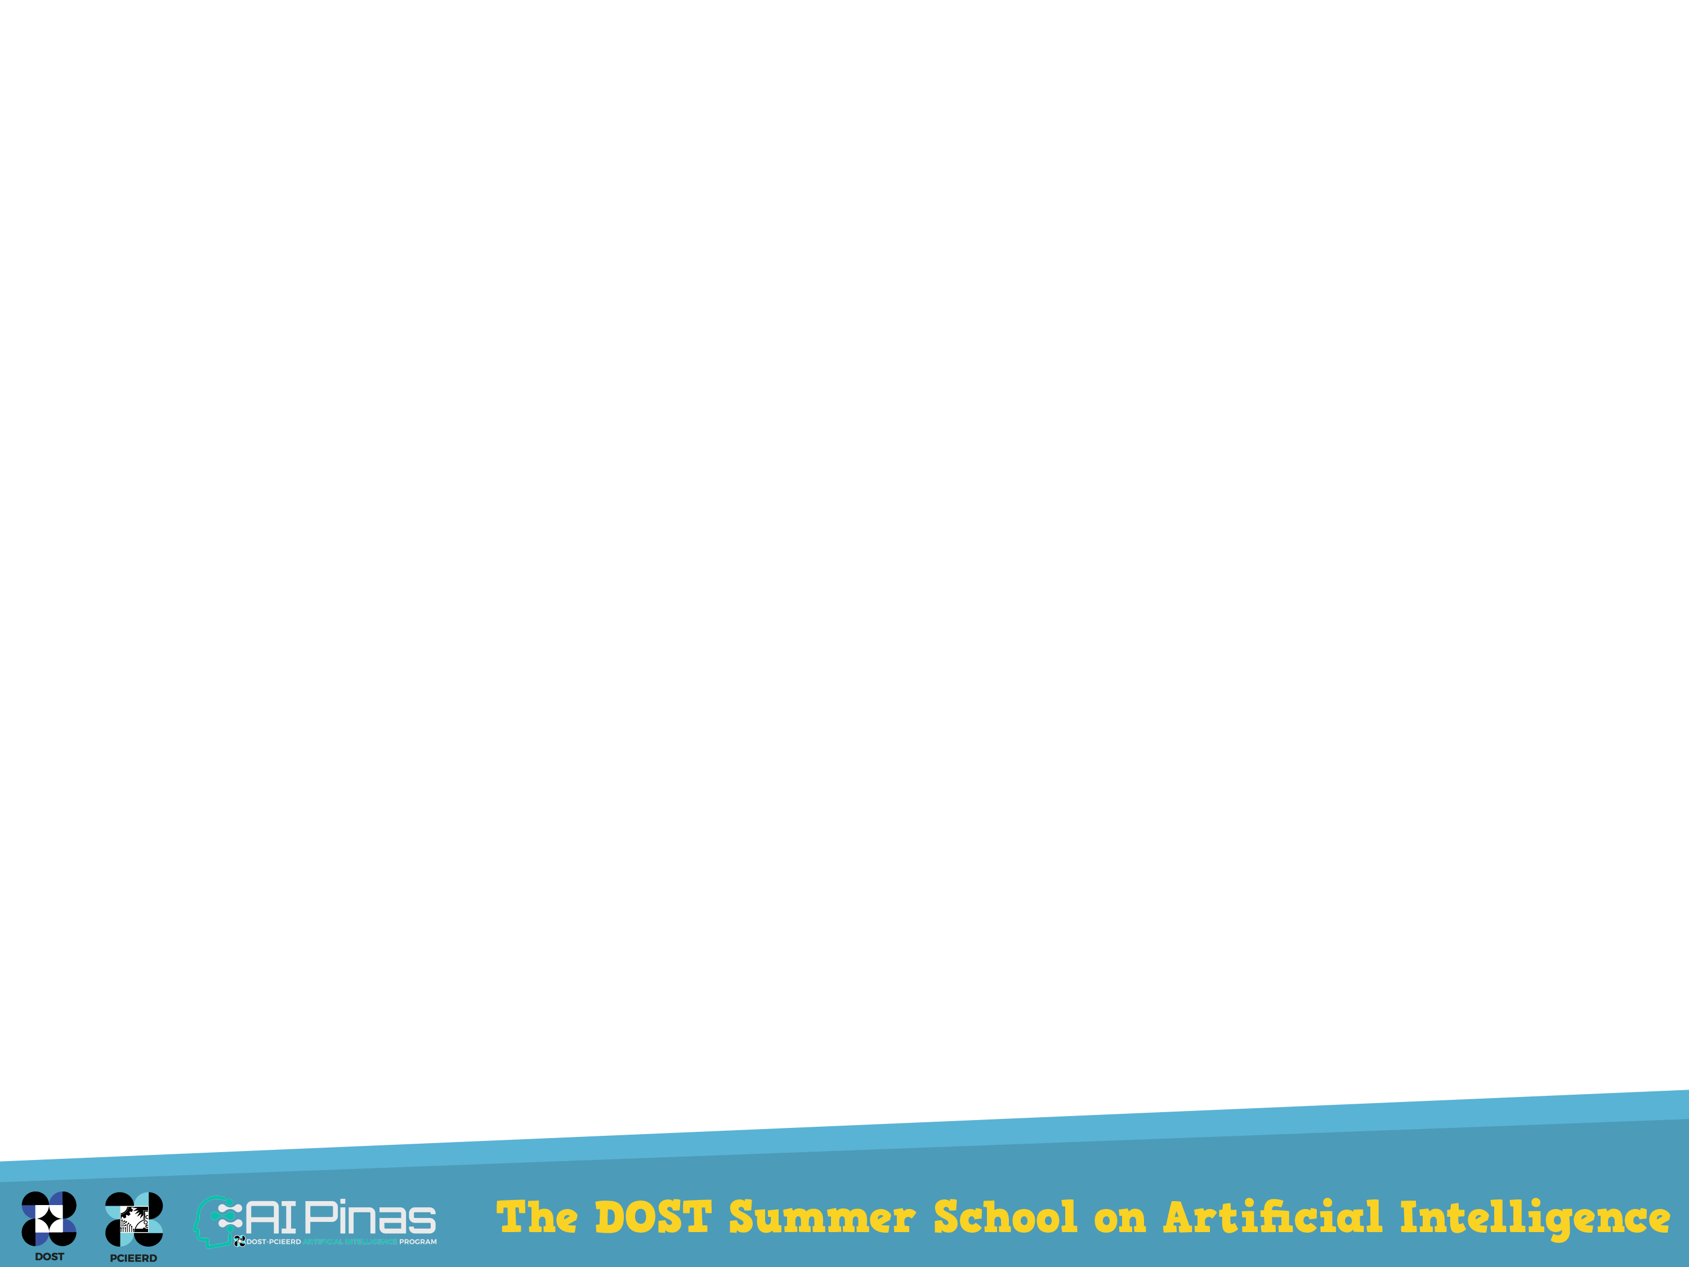
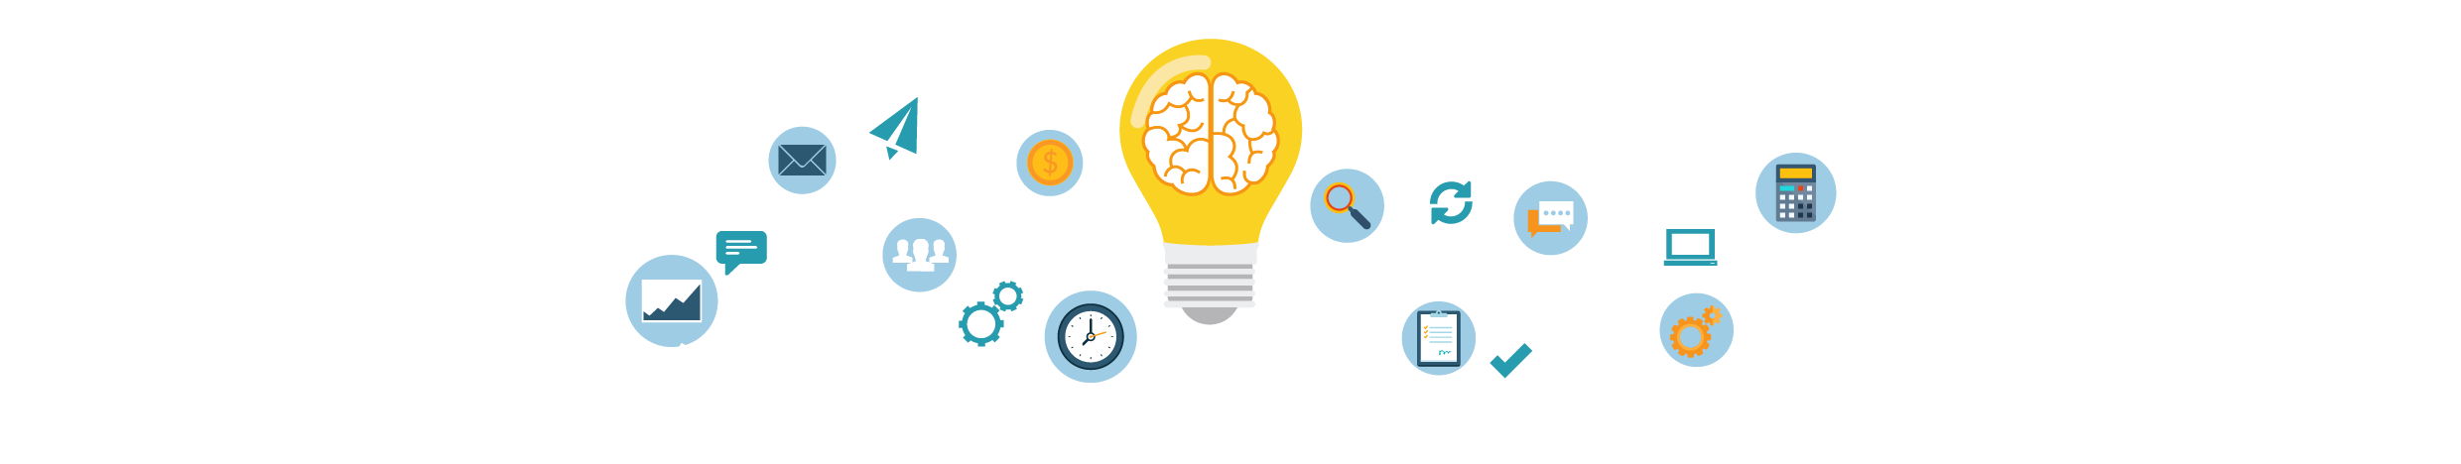
Support Vector Machine
With an Introduction to Supervised Learning
Kardi Teknomo (ADMU)
Kristofer delas Penas (UPD)

Slide 2
Overview & Learning Objectives
Supervised Learning
SVM
Concept
Separable case
Non separable case
Kernel
Kernel Trick

Slide 3
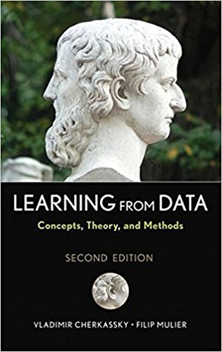
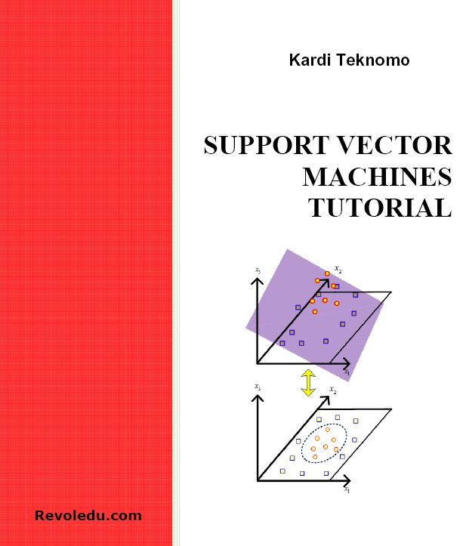
Part 2: Support Vector Machine

Slide 4
What is SVM?
Support Vector Machine (SVM) is a supervised learning algorithm that classify both linear and nonlinear data based on maximizing margin between support points and a nonlinear mapping to transform the original training data into a higher dimension

Slide 5
SVM—History
Vapnik and Cortes and colleagues (1992)—groundwork from Vapnik & Chervonenkis’ statistical learning theory in 1960s

Slide 6
SVM Applications
SVM has been succesfully applied to the following applications
handwritten digit recognition
object recognition
speaker identification
benchmarking time-series prediction tests
Speech Recognition
Data Base Marketing
Quark Flavors in High Energy Physics
Dynamic Object Recognition
Knock Detection in Engines
Protein Sequence Problem
Text Categorization
Breast Cancer Diagnosis

Slide 7
Intuitive Illustration
Find a linear hyperplane (decision boundary) that will separate the data

Slide 8
Intuitive Illustration
One Possible Solution

Slide 9
Intuitive Illustration
Another possible solution

Slide 10
Intuitive Illustration
Other possible solutions

Slide 11
Intuitive Illustration
Which one is better? B1 or B2?
How do you define better?

Slide 12
Intuitive Illustration
Find hyperplane maximizes the margin => B1 is better than B2

Slide 13
Another way to look at it
Best Linear Separator?

Slide 14
Closest Points in Convex Hulls
d
c

Slide 15
Plane Bisect Closest Points
d
c

Slide 16
Margins and Complexity
Skinny margin
is more flexible
thus more complex.

Slide 17
Margins and Complexity
Fat margin
is less complex.

Slide 18
High Quality Data
Support Vector
Number of data
(balance or imbalance) does not matter

Slide 19
Support Vectors
Support vectors = closest points to the separating hyperplane
Small Margin
Large Margin
Support Vectors

Slide 20
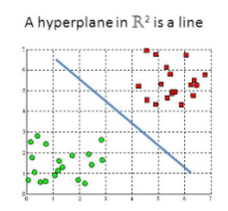
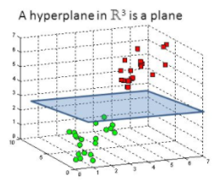
What is hyperplane?
a hyperplane in R^{n} is a subspace of n-1 dimension.
1D = A point: w₁x₁+b=0
2D = A line: w₁x₁+w₂x₂+b=0
3D = A plane: w₁x₁+w₂x₂+w₃x₃+b=0
4D = a hyperplane: w₁x₁+w₂x₂+w₃x₃+w₄x₄+b=0
Linear Kernel

Slide 21
2 classes, linearly separable
Given a set of training data
The linear classifier would be a hyperplane in characterized by a normal w and an offset b

Slide 22
2 classes, linearly separable
For linearly separable dataset T, there exist a hyperplane that satisfies all the points in T
It can be written more compactly as

Slide 23
2 classes, linearly separable
There are infinite solution (w, b) that satisfies constraint
To make the solution unique, we normalize through rescaling (w, b) so that the closest points to the hyperplane satisfy the constraint
The normalization leads to the canonical form of SVM

Slide 24
Normalized Margin
Separating hyperplane
margin hyperplane
margin hyperplane

Slide 25
Distance from hyperplane
Due to normalization, the distance from separating hyperplane to any point becomes

Slide 26
Separable case formulation
We want to maximize:
Which is equivalent to minimizing function:
Subjected to constraints:
(Quadratic is easier than square root)

Slide 27
Separable case formulation: Hard margin
The goal of SVM is to find the pair hyperplane that maximize the margin, or equivalently
This is a convex constrained optimization problem that guaranteed to get the global solution
It is called Quadratic Programming (QP) because

Slide 28
Classification
Once you obtain the parameters of hyperplane (w, b), you can compute the margin score
Classification is simply sign of the score

Slide 29
Classification Based on Support Vectors
Assume b=0 (shift the plane such that (0,0) is at the separating hyperplane)
parameter if n is support vector
parameter if n is not support vector

Slide 30
Drawing 2D hyperplane
Only for 2D: Plot (x1, x2)
Given x1 from data, compute x2
Separating hyperplane
Margin hyperplane

Slide 31
2 classes, linearly inseparable
What if the problem is not linearly separable?
Use slack variables AND
Use Kernel trick

Slide 32
Using Slack variables: Soft-Margin
Introduce positive slack variable s_{i} to penalize misclassification
Slack variable s_{i} is larger than 1 if x_{i} is misclassified
Regularization parameter c
Source: Teknomo (2012) Support Vector Machine Tutorial, Revoledu.com

Slide 33
Cost function
Penalty or cost function
is the upper bound on the average loss on the training data
Regularization Parameter c is chosen by user to tolerate error. Larger value of c indicates higher penalty to error. If c = infinite, then no error can be tolerated

Slide 34
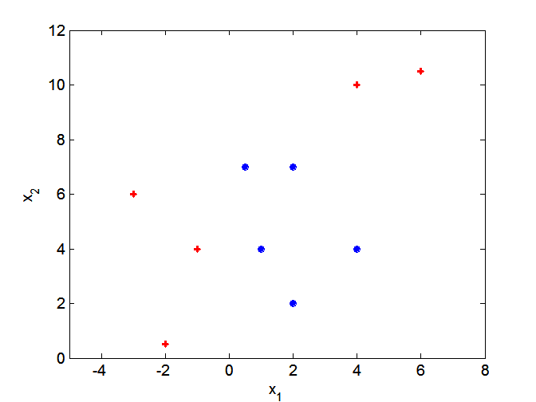
Non-Linear Decision Boundary
What if decision boundary is not linear?

Slide 35
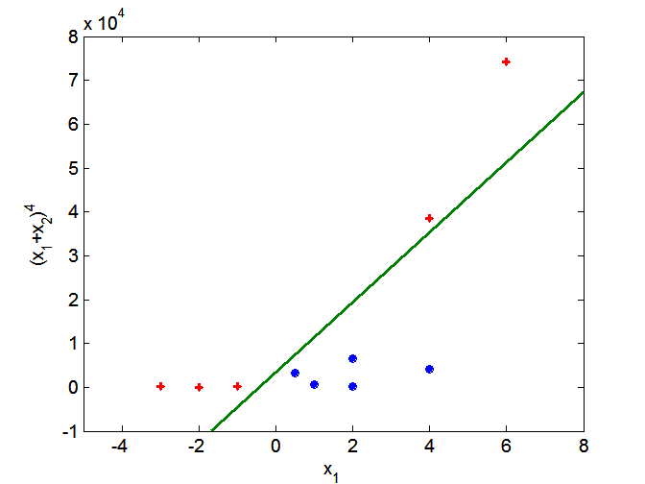
Kernel Trick
Kernel is a transformation function (especially, from non-linear to linear)
Transform data into higher dimensional space
Search for a linear separating hyper plane in the new space
Kernel trick: You do not need to know the mapping function

Slide 36
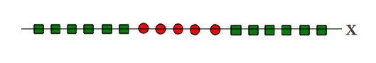
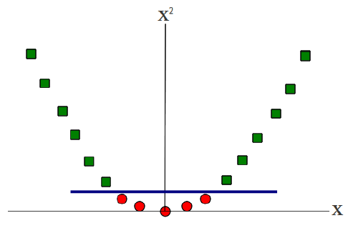
Example
ID
x
Non-Linearly separable
2D
[x, x²]
Linearly separable

Slide 37
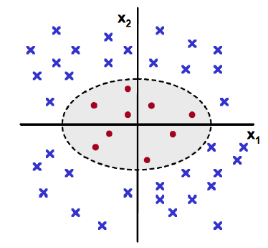
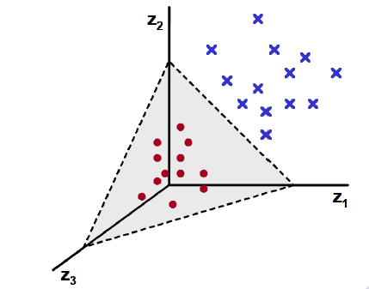
Example
2D
[x1,x2]
3D
mapping:

Slide 38
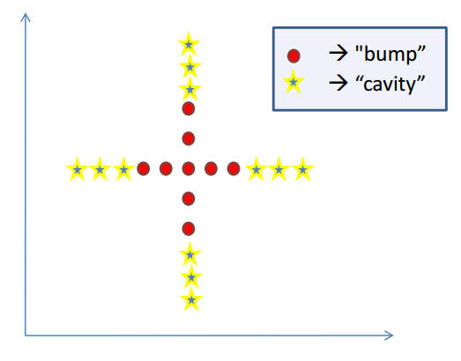
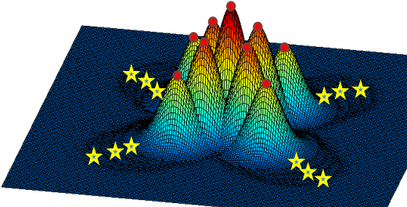
Example

Slide 39
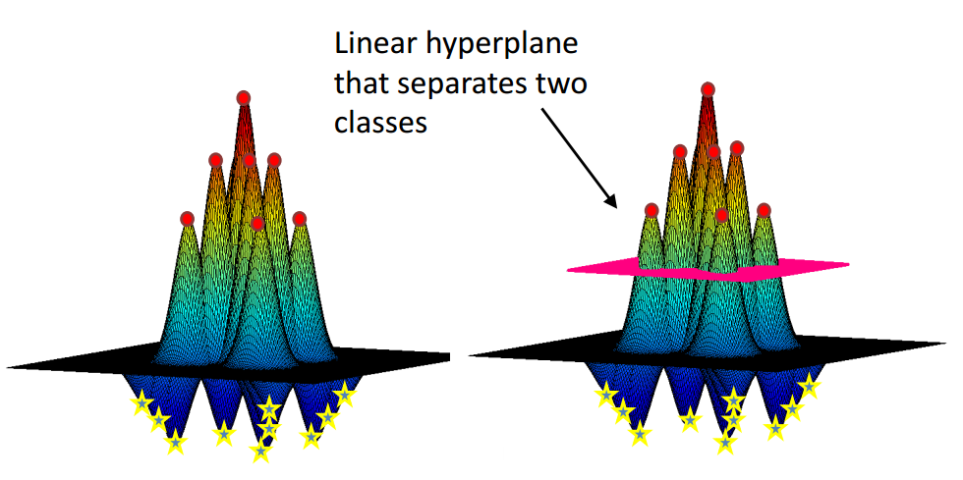
Linear Separating hyperplane

Slide 40
Kernel
Often used Kernel in the literature:
Polynomial
Radial Basis
Neural Network
Transform the kernel into a mapping function by square root of each Kernel‘s term

Slide 41
Mapping Function Example
For example we have 1D data of x
We use polynomial kernel degree 2
Thus, the mapping function is

Slide 42
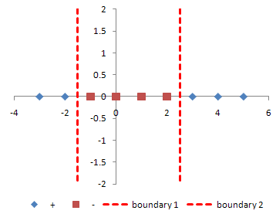
Example: 1D->3D
Given 1D data x_{i} below, transform into 3D and find the SVM separating hyperplane
Use Mapping Function
X | 1 | 2 | 3 | 4 | 5 | 6 | 7 | 8 | 9
y | + | + | - | - | - | - | + | + | +

Slide 43
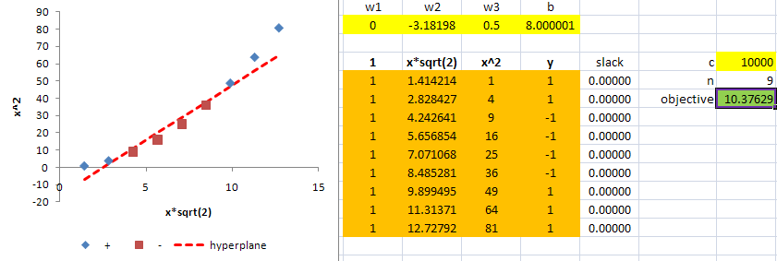
Answer

Slide 44
Practice
Suppose x has two inputs:
Find mapping function using polynomial kernel degree 2

Slide 45
Answer
Given 2D data
Kernel
Mapping function become 6D

Slide 46
Practice
Suppose x has two inputs:
Find mapping function using polynomial kernel degree 2
Compare your result with previous practice

Slide 47
Answer
Given 2D data
Kernel
Mapping function become 3D

Slide 48
Dual SVM
In practice the following formulation is what we use
Source: Cherkassy, Muller (2010) Learning from Data 2nd Edition

Slide 49
How to use Kernel in SVM?
Remember
We map

Slide 50
Dual SVM overcome curse of dimensionality
Decision in Primal formulation: sum over all features j
Decision in Dual formulation: sum over number of Support Vectors
curse of dimensionality

Slide 51
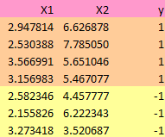
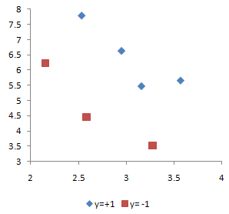
Example Dataset-1
Find hyperplane weights (w, b) that separate the following data optimally

Slide 52
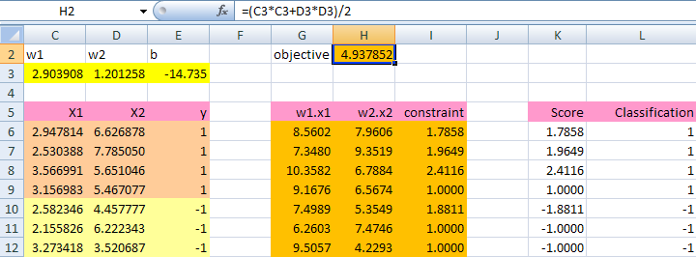
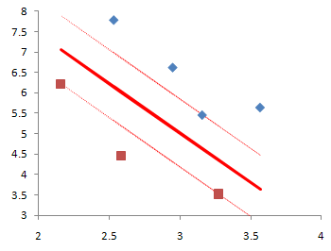
Answer
Constraint:
Margin Score:

Slide 53
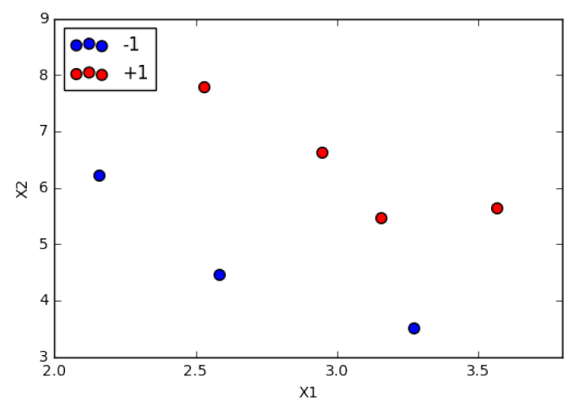
Scatter Plot of the data

Slide 54
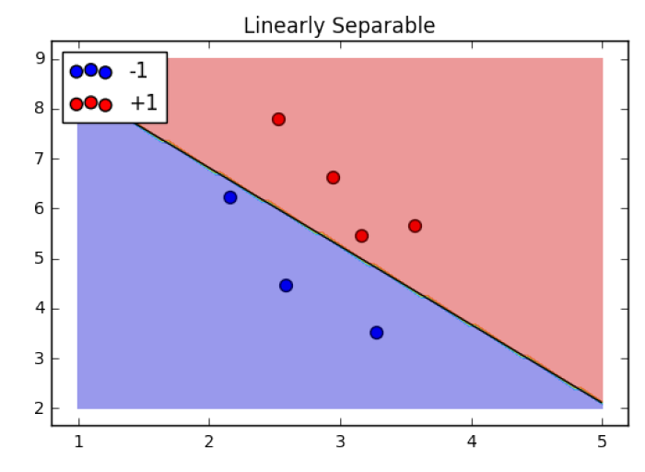
Separating Hyperplane
Source: http://people.revoledu.com/kardi/tutorial/SVM/SVM+in+Python.html

Slide 55
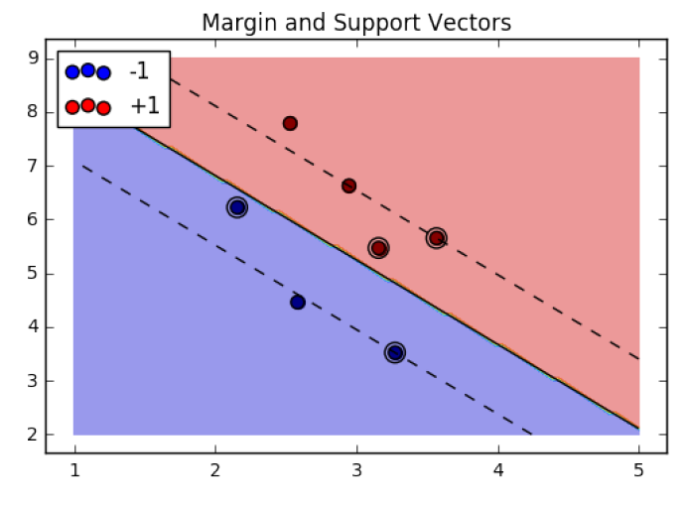
Margin and Support Vector
Source: http://people.revoledu.com/kardi/tutorial/SVM/SVM+in+Python.html

Slide 56
Prediction
Using result of Practice-1, predict the class of previously unseen data
X1= 3
X2= 6
Optionally, you can compare the results of this Practice (using SVM) with the results of LDA from http://people.revoledu.com/kardi/tutorial/LDA/Numerical%20Example.html

Slide 57
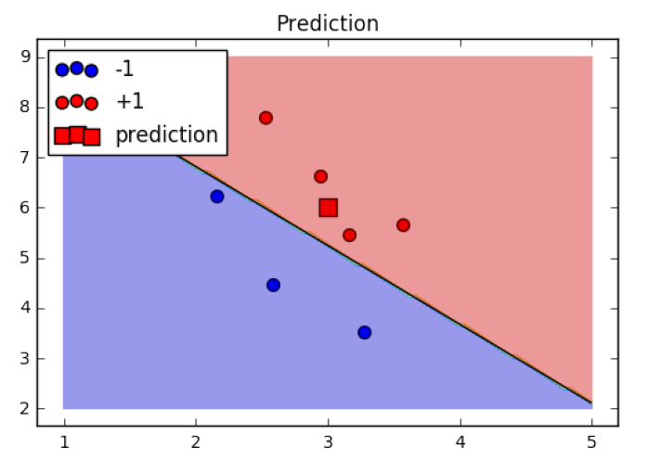
Prediction
Source: http://people.revoledu.com/kardi/tutorial/SVM/SVM+in+Python.html

Slide 58
Example
Find the constraint value if you use the optimum separating hyperplane in practice 1 and data in practice 2, but for class y=+1 and for class y=-1
Can you predict the classification based on constraint value alone?

Slide 59
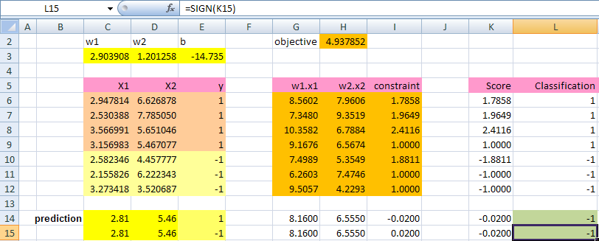
Answer

Slide 60
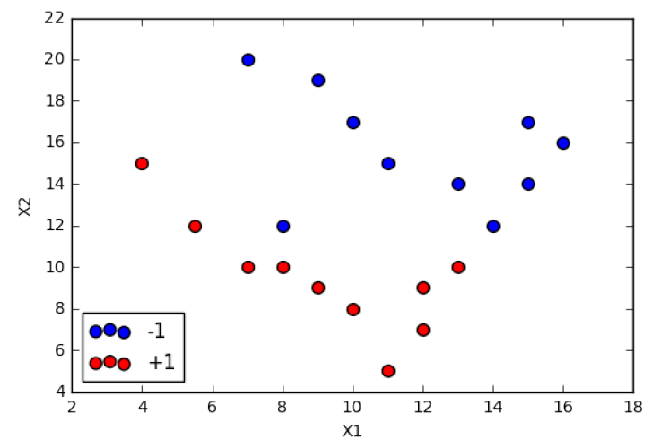
Practice Dataset-2

Slide 61
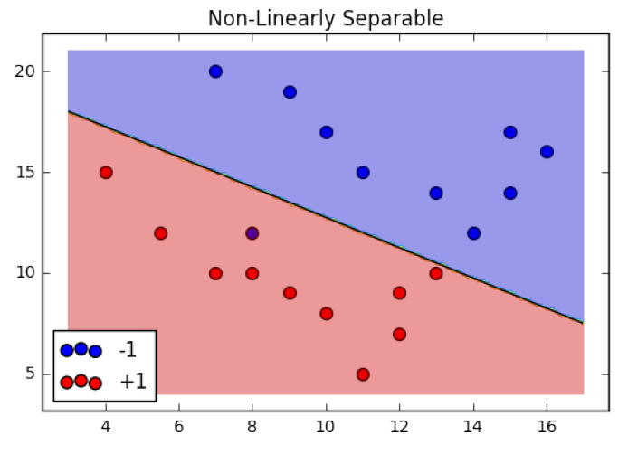
Non-Linearly Separable
Source: http://people.revoledu.com/kardi/tutorial/SVM/SVM+in+Python.html

Slide 62
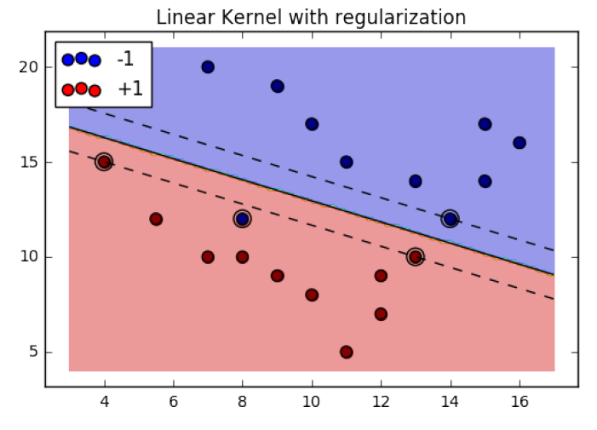
Linear Kernel and Regularization
Source: http://people.revoledu.com/kardi/tutorial/SVM/SVM+in+Python.html

Slide 63
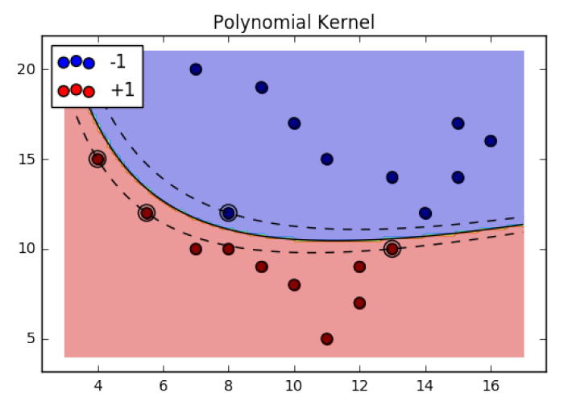
Non-Linear Kernel
Source: http://people.revoledu.com/kardi/tutorial/SVM/SVM+in+Python.html

Slide 64
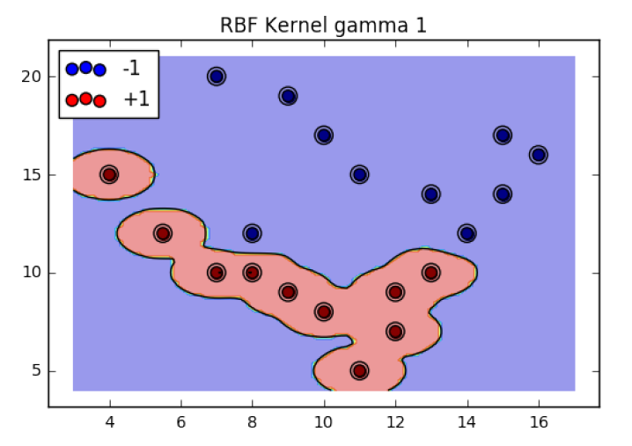
Non-Linear Kernel: Overfitting
Source: http://people.revoledu.com/kardi/tutorial/SVM/SVM+in+Python.html

Slide 65
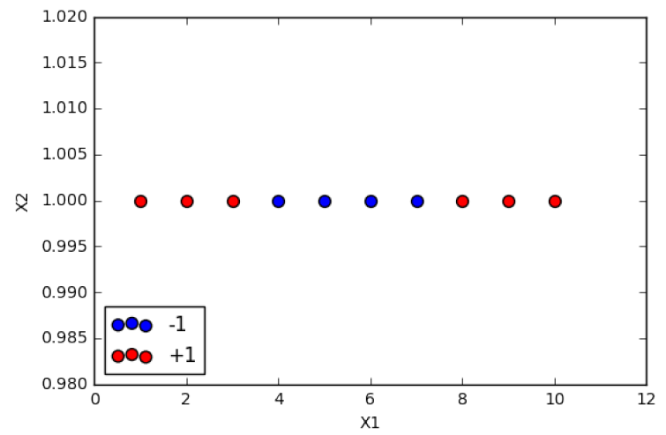
1D Data (Dataset 3)

Slide 66
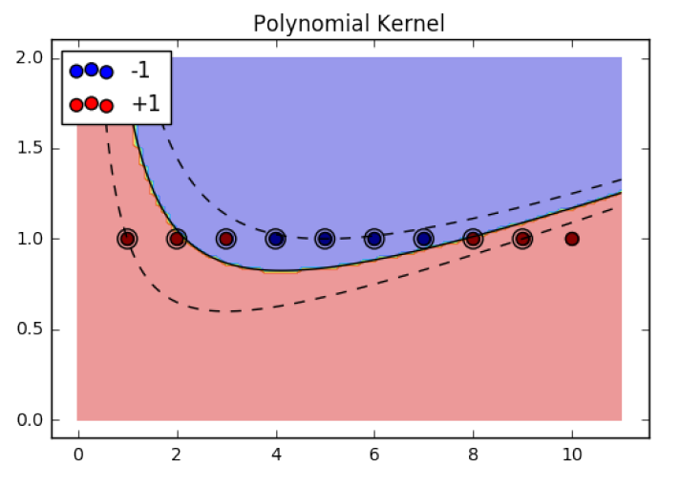
Polynomial Kernel Degree 2
Accuracy = 90%
Support Vector = 9 out of 10 points
Source: http://people.revoledu.com/kardi/tutorial/SVM/SVM+in+Python.html

Slide 67
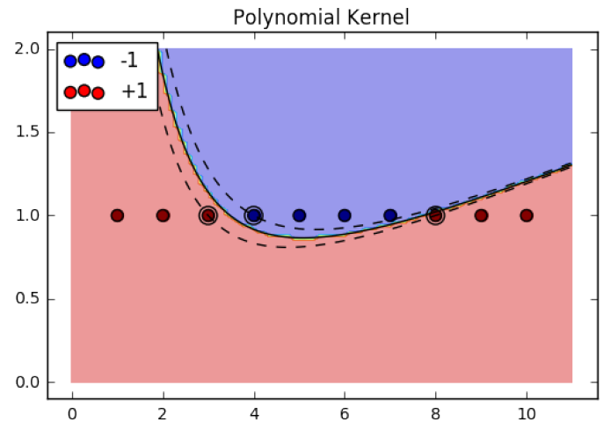
Polynomial Kernel Degree 3
Accuracy = 100%
Support Vector = 3 out of 10 points
Source: http://people.revoledu.com/kardi/tutorial/SVM/SVM+in+Python.html

Slide 68
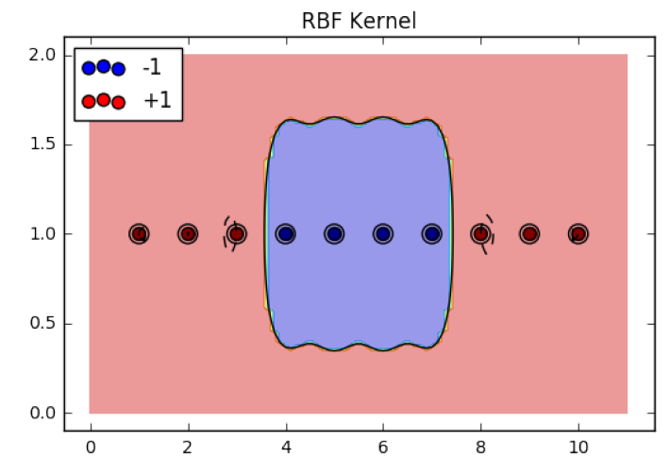
RBF Kernel - Overfitting
Accuracy = 100%
Support Vector = 10 out of 10 points
Source: http://people.revoledu.com/kardi/tutorial/SVM/SVM+in+Python.html

Slide 69
Assignment
Create 2D data that linearly non-separable like the following figure
Use the following mapping function to solve SVM separating hyperplane

Slide 70
Transformation of space

Slide 71
Assignment
Create any 3D of X data and their binary classes
Transform (x₁,x₂,x₃) into 6D:
Find the SVM separating hyperplane using slack variables

Slide 72
SVM for multi classes
If number of classes is larger than 2, there are several strategies such as:
Winner takes all:
Label all training points as y_{i}=j with +1, all other y_{i}≠j as -1 for each class j
Get the score
In the test stage, final decision function is
DAGSVM:
make a directed acyclic graph of consecutive binary classifications to build decision tree class hierarchy

Slide 73
Strength of SVM
Strong generalization guarantees derived from the max margin property
Able to use very high dimensional feature spaces using kernel trick
Accuracy is high owing to their ability to model complex nonlinear decision boundaries (margin maximization)
General methodology for many types of problems
Same Program + New Kernel = New method
Support vectors = quality data

Slide 74
Limitation of SVM
Training can be slow
Unclear on how to chose parameter c and Kernel?
Unclear on how to handle categorical independent variables?
Unclear on how to interpret results?
Runing time is polynomial in the number of classes (for multiclass problem)
Cannot jointly classify correlated instances in a systematic way
Cannot model correlation and dependencies among different instances as in graphical model

Slide 75
SVM-Summary
m
Let data D be (X₁, y₁), …, (X_{|D|}, y_{|D|}), where X_{i} is the set of training tuples associated with the class labels y_{i}
There are infinite lines (hyperplanes) separating the two classes but we want to find the best one (the one that minimizes classification error on unseen data)
SVM searches for the hyperplane with the largest margin, i.e., maximum marginal hyperplane (MMH)

Slide 76
SVM-Summary (contd)
With the new dimension, it searches for the linear optimal separating hyperplane (i.e., “decision boundary”)
With an appropriate nonlinear mapping to a sufficiently high dimension, data from two classes can always be separated by a hyperplane
SVM finds this hyperplane using support vectors (“essential” training tuples) and margins (defined by the support vectors) ➔ high quality data

Slide 77
Comparison NN, NB, SVM
Neural Network
Functional
Can approximate any function
Non necessarily optimal
Naïve Bayes
More data produces better results
Lazy Learning (wait for test data)
Imbalance data influence the prior
SVM
Support Vector = Quality Data (others does not matter)
Optimal = max margin
Linear
Binary

Slide 78
SVM Resources
http://www.support-vector.net/
http://www.kernel-machines.org/
http://people.revoledu.com/kardi/tutorial/SVM/
http://people.revoledu.com/kardi/tutorial/SVM/SVM+in+Python.html
Representative implementations
LIBSVM: an efficient implementation of SVM, multi-class classifications, nu-SVM, one-class SVM, including also various interfaces with java, python, etc.
Scikit-learn: for python
SVM-light: simpler but performance is not better than LIBSVM, support only binary classification and only C language
SVM-torch: another recent implementation also written in C.

Slide 79
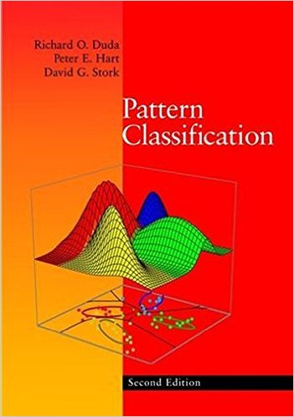
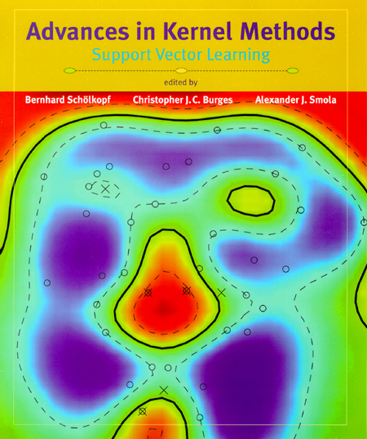
SVM Literatures
“Statistical Learning Theory” by Vapnik
C. J. C. Burges. A Tutorial on Support Vector Machines for Pattern Recognition. Knowledge Discovery and Data Mining, 2(2), 1998.
N. Cristianini and J. Shawe-Taylor, An Introduction to Support Vector Machines
Teknomo, Support Vector Machine Tutorial, Revoledu.com
Duda, Hart & Stork, Pattern Classification

Slide 80
Review
Can you explain the keywords for SVM?
Maximum Margin
Linear Classifier
Kernel Trick
Support Vector
Quality Data
Duality Theory

Slide 81
Discussion
How do you compare SVM and PCA in dimensional reduction and data reduction?
Why do we need to reduce dimension?
Why PCA can reduce dimension?
Why SVM increase the dimension?
Why SVM can reduce data?
Why do we need to reduce data to quality data?
What are the possible application of quality data?

Slide 82
Copy right
Permission is granted to use, modify and distribute this slide as long as the copy right page remain intact and unmodified.
Copyright © 2017 Kardi Teknomo (http://people.revoledu.com/kardi/tutorial/)

